Slide 1
Introduction to Continuous Integration
MODULE 1 – Continuous Integration

Slide 2
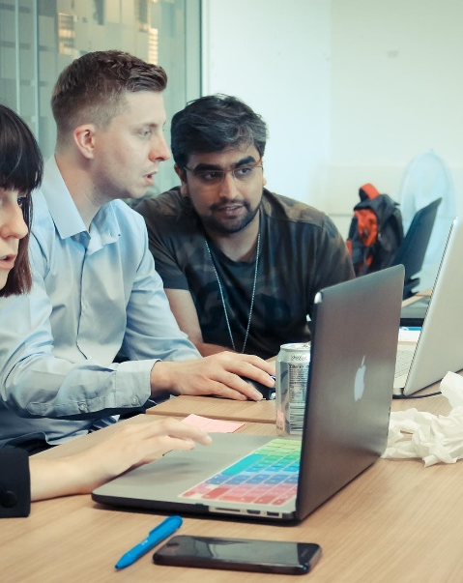
Presentation Contents
What is Continuous Integration?
What is Continuous Delivery?
Database objects

Slide 3
Course objectives
Describe what the culture of DevOps is
Discuss the differences between continuous integration, deployment and delivery

Slide 4
IT before DevOps
Teams used to work very separately from each other during project work
Developers, testers, operations, security, etc.
It was easy for each team to see the shortcomings of other teams
Developers didn’t ship fast enough, operations took too long to deploy, testers missed vital bugs
Only creates toxicity in the workplace

Slide 5
Miscommunication = Waste
If teams aren’t working together and miscommunicating, there will be a lot of waste
Technical waste - not fully understanding the structure of IT in the business means we don’t understand how to utilise it
Time waste - waiting for teams to complete their function (approvals, code deployment, environments, tests)
Manual waste - teams working for hours for software updates, having to run 100’s of manual tests
To eliminate this waste, we need a way to align people to processes and technology…

Slide 6
The DevOps Phenomenon
DevOps is a culture that revolves around eliminating waste and aligning people, processes and technology
Focused around automation of a cycle from development to deployment
Feedback is extremely important, as DevOps is about bridging the gaps between teams
All organisations should have a way to share information for improvements
Not as easy as the dev’s telling the op’s team what to do, or vice versa

Slide 7
Working in DevOps
Automation around process is a big part of DevOps, and this typically focuses around three main areas:
Continuous Integration - Integration and testing of new features into software
Continuous Delivery – Deploying safe-working code into a staging environment
Continuous Deployment - Deployment of applications to a customer for usage

Slide 8
Continuous Integration
Continuous Integration, or CI, is a software development practice that revolves around merging changes often
Different features are combined, or integrated, frequently to expose issues quickly
Automating the following areas is key:
Integration of code – different branches and features managed and merged through a version control system
Build automation – running the code to compile once it has been merged together
Test automation – running automated tests alongside the build of a project to see if it works as expected

Slide 9
Continuous Delivery
Continuous delivery extends on CI, ensuring that you can release new changes to customers quickly
You can schedule releases (daily, weekly, monthly, etc.) but it’s suggested to release as often as possible!
This is specifically to see whether the product is ready for customers
We automate the deployment to a staging environment – an environment that mimics the production environment as closely as possible
Once we’ve verified that it works in this staging environment, it should work in a production environment

Slide 10
Continuous Deployment
Continuous Deployment extends even further on Continuous Delivery, automating the full process
This means automating deployment into a customer-facing environment – the production environment!
As you can probably assume, this is quite the difficult and stressful task!
If anything is wrong with a feature, it could be seen by customers
This is the end goal of most companies – automating everything where possible!

Slide 11
Activity – CI in action
Directions
Pairs, 10 mins
Research online about a company that utilises CI and CD principles within their business
Debrief
Share your research and thoughts with the rest of the room

Slide 12

CI in action – Facebook Mobile
Facebook is one of the biggest social media platforms and has 2.3 billion monthly active mobile users as of the third quarter of 2018 (source: https://www.statista.com/)
Christian Legnitto discussed the way Facebook developed their mobile platform in 2014
Number of different teams – messages, photos, Android, iOS, events
Have over 100,000 commits to their Git repository
300 contributers with over 150,000 files
Notes:
Really good video around this case study: https://www.infoq.com/presentations/Facebook-Release-Process

Slide 13
CI in acion - Facebook
Code review – Phabricator
CI tool – Buildbot with Buck as a build tool
Testing – Lint, JUnit, Static Analysis, OCUnit
Version Control
Create the difference
Difference updated
Commit to repo
Build code
Static analysis
Tests
Build process

Slide 14
CI pipeline
Source Code
Pull
Version Control System
Get Work
Developers
Project Tracking
Push
Update Work
Email the Dev’s
Pull Code
Poll Code
Send Code
Email Server
CI Server
Build Tool
DevOps
Build Report
Build Results
Run Tests
Test Results
Send artefact
Automated Testing
Artefact Repository
Test artefact
Live Environment
Testers
Testing Environment
Staging Environment
Environment Testing Done
Staging Passed
Notes:
Take the consultants through each section, pointing out each section and have an open discussion with the room about it.

Slide 15
Activity – CI Lab 1
Directions
Complete lab 1
3 hours – small teams
Debrief
Present your pipeline to the class

Slide 16
Course Objectives - Summary
Describe what the culture of DevOps is
DevOps is a software development technique that focuses on automating as much as possible so people, process and technology are aligned
Discuss the differences between continuous integration, deployment and delivery
Continuous Integration is around the integration and testing of new features into software
Continuous Delivery is around deploying safe-working code into a staging environment
Continuous Deployment is around deployment of applications to a customer for usage

Slide 17
Thank you for listening.
Any questions?

